Slide 1
The Data Link Layer
Lecturer: Ngo Huy Bien
Software Engineering Department
Faculty of Information Technology
VNUHCM - University of Science
Ho Chi Minh City, Vietnam
nhbien@fit.hcmus.edu.vn

Slide 2

Objectives

Slide 3

Contents

Slide 4

References
Andrew S. Tanenbaum and David J. Wetherall (2021). Computer Networks. Pearson Education.
James F. Kurose and Keith W. Ross (2021). Computer Networking: A Top-Down Approach. Pearson.

Slide 5
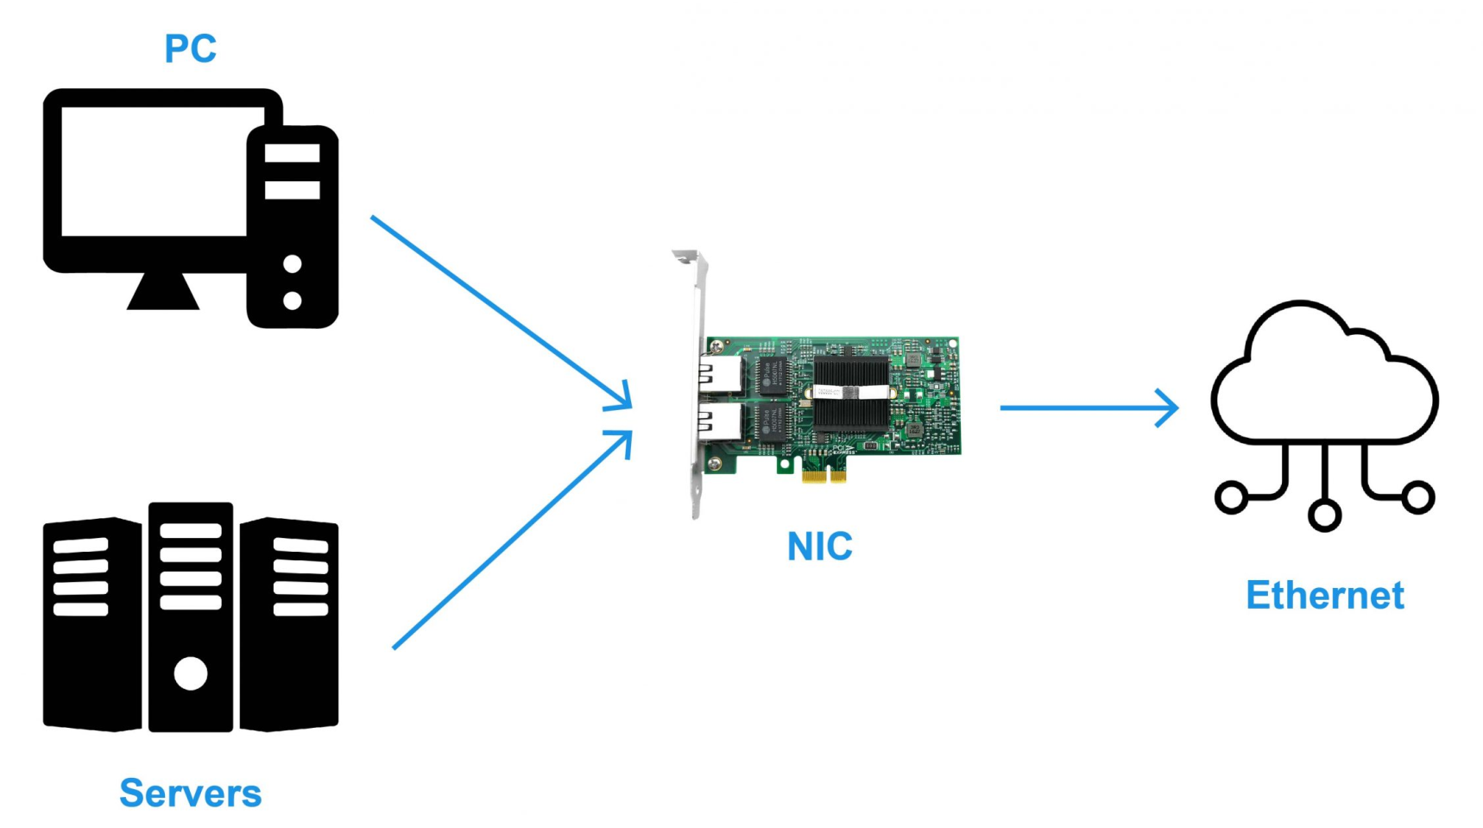
Ethernet
Data Link layer: The layer in which the first protocols are introduced. This layer is responsible for defining a common way of interpreting signals, so network devices can communicate.
Collision domain: A network segment where only one device can communicate at a time.
Ethernet: The protocol most widely used to send data across individual links.

Slide 6
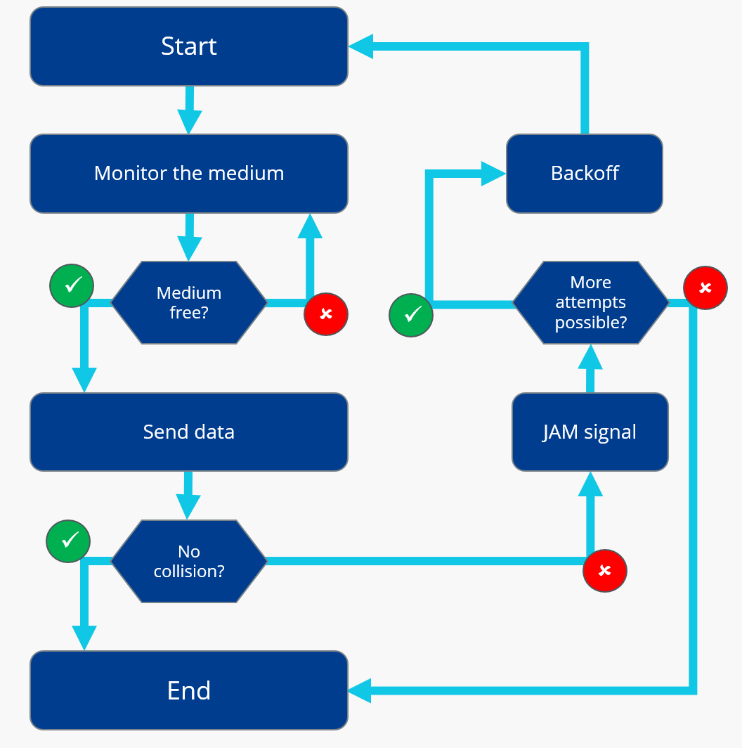
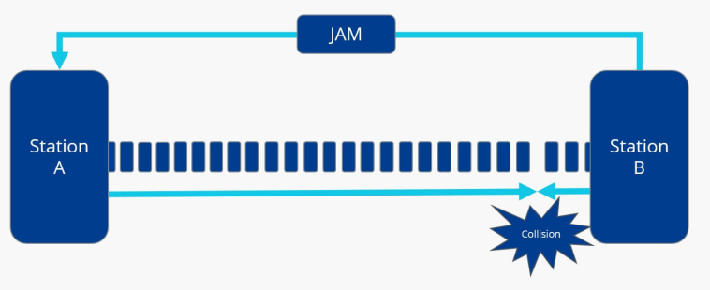
CSMA/CD
Carrier-Sense Multiple Access with Collision Detection (CSMA/CD): CSMA/CD protocol is used to determine when the communications channels are clear and when the device is free to transmit data.

Slide 7
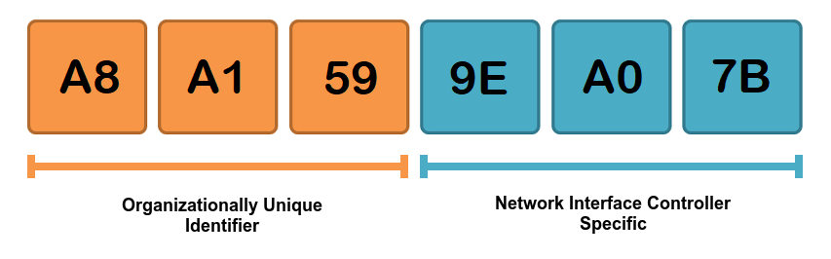
MAC Address
MAC (Media Access Control) address: A globally unique identifier attached to an individual network interface. It's a 48-bit number normally represented by six groupings of two hexadecimal numbers.
Hexadecimal: A way to represent numbers using a numerical base of 16.

Slide 8


Slide 9
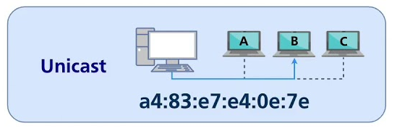
Unicast Transmission
Unicast transmission: A unicast transmission is always meant for just one receiving address.

Slide 10
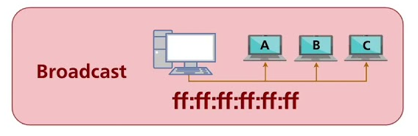
Broadcast
Broadcast: A type of Ethernet transmission, sent to every single device on a LAN.
Broadcast address: A special destination used by an Ethernet broadcast composed by all Fs.

Slide 11
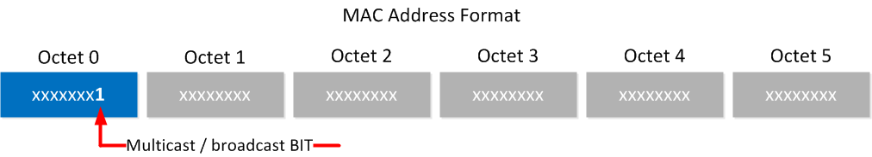
Multicast
Multicast frame: If the least significant bit in the first octet of a destination address is set to one, it means you're dealing with a multicast frame.
A multicast frame is similarly set to all devices on the local network signal, and it will be accepted or discarded by each device depending on criteria aside from their own hardware MAC address.

Slide 12
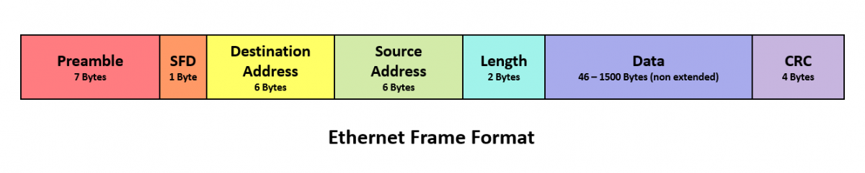
Data Packet
Data packet: An all-encompassing term that represents any single set of binary data being sent across a network link.

Slide 13
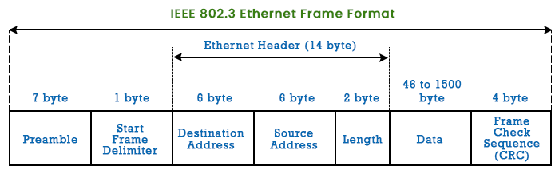
Ethernet Frame (I)
Ethernet frame: A highly structured collection of information presented in a specific order.
Preamble: The first part of an Ethernet frame, it is 8 bytes or 64 bits long and can itself be split into two sections.
Start Frame Delimiter (SFD): The last byte in the preamble, that signals to a receiving device that the preamble is over and that the actual frame contents will now follow.
Source MAC address: The hardware address of the device that sent the ethernet frame or data packet. In the data packet it follows the destination MAC address.

Slide 14
Ethernet Frame (II)
Payload: The actual data being transported, which is everything that isn't a header.
Cyclical Redundancy Check (CRC): A mathematical transformation that uses polynomial division to create a number that represents a larger set of data. It is an important concept for data integrity and is used all over computing, not just network transmissions.

Slide 15
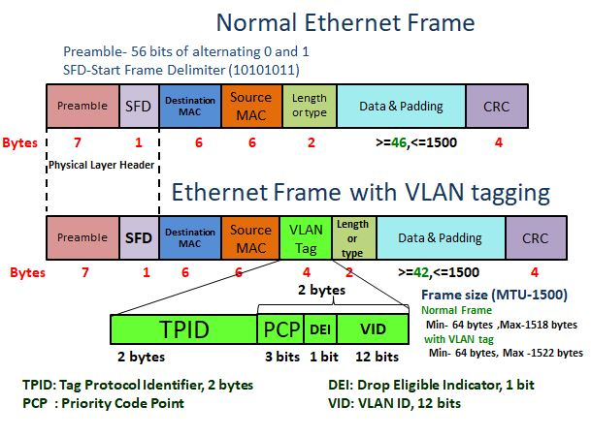
Ethernet Frame (III)
Virtual LAN (VLAN): It is a technique that lets you have multiple logical LANs operating on the same physical equipment.
VLAN header: A piece of data that indicates what the frame itself is. In a data packet it is followed by the EtherType

Slide 17
Unicast
Point-to-point links connect individual pairs of machines.
To go from the source to the destination on a network made up of point-to-point links, short messages, called packets in certain contexts, may have to first visit one or more intermediate machines.
Often multiple routes, of different lengths, are possible, so finding good ones is important in point-to-point networks.
Point-to-point transmission with exactly one sender and exactly one receiver is sometimes called unicasting.

Slide 18
Broadcast
In contrast, on a broadcast network, the communication channel is shared by all the machines on the network; packets sent by any machine are received by all the others.
An address field within each packet specifies the intended recipient.
Upon receiving a packet, a machine checks the address field.
If the packet is intended for the receiving machine, that machine processes the packet; if the packet is intended for some other machine, it is just ignored.

Slide 19
Multicast
Broadcast systems usually also allow the possibility of addressing a packet to all destinations by using a special code in the address field.
When a packet with this code is transmitted, it is received and processed by every machine on the network.
This mode of operation is called broadcasting.
Some broadcast systems also support transmission to a subset of the machines, which known as multicasting.

Slide 20
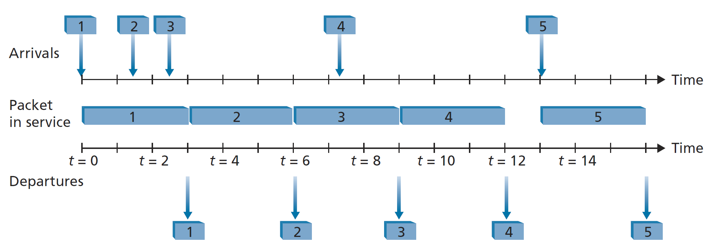
First-in-First-Out (FIFO) (I) [2]
Let's now return to the question of determining the order in which queued packets are transmitted over an outgoing link.
The FIFO (also known as first-come-first-served, or FCFS) scheduling discipline selects packets for link transmission in the same order in which they arrived at the output link queue.

Slide 21
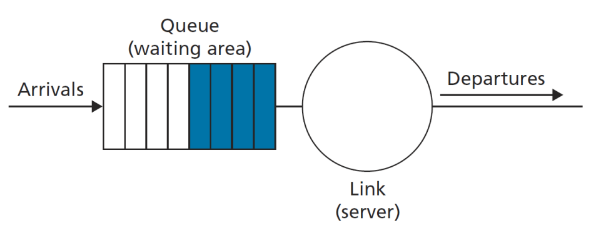
First-in-First-Out (FIFO) (II)
Packets arriving at the link output queue wait for transmission if the link is currently busy transmitting another packet.
If there is not sufficient buffering space to hold the arriving packet, the queue's packet-discarding policy then determines whether the packet will be dropped (lost) or whether other packets will be removed from the queue to make space for the arriving packet.

Slide 23
Medium Access Control Protocols
A Medium Access Control (MAC) protocol exists because multiple devices share the same physical communication medium (e.g., radio channel, Ethernet cable, optical link), and they need a rule set to coordinate access — otherwise, simultaneous transmissions would interfere or collide, corrupting data.
Scenario | Without MAC Protocol | With MAC Protocol
Ethernet LAN | All devices transmit simultaneously → collisions, chaos | CSMA/CD ensures only one transmitter succeeds
Wi-Fi | Radio interference from overlapping users | CSMA/CA avoids simultaneous transmission
Cellular networks | Overlapping frequency usage | TDMA/CDMA allocate time/frequency/code resources
Sensor networks | Battery waste due to idle listening | Energy-aware MAC schedules transmissions

Slide 24
MAC Protocols: Contention-Based (Random Access) Protocols
ALOHA – The earliest MAC protocol, developed at the University of Hawaii.
Slotted ALOHA – Divides time into discrete slots to reduce collisions.
CSMA (Carrier Sense Multiple Access) – Devices sense the channel before transmitting.
CSMA/CD (Collision Detection) – Used in wired Ethernet (IEEE 802.3).
CSMA/CA (Collision Avoidance) – Used in Wi-Fi (IEEE 802.11).

Slide 25
MAC Protocols: Controlled Access (Deterministic) Protocols
Token Passing – Used in Token Ring (IEEE 802.5) and Token Bus (IEEE 802.4).
Polling – A central controller invites each node to transmit in sequence.
Reservation-Based Protocols – Nodes reserve time slots in advance, used in real-time or wireless sensor networks.

Slide 26
MAC Protocols: Hybrid and Advanced MAC Protocols
IEEE 802.15.4 MAC – Hybrid MAC for low-rate wireless personal area networks (e.g., ZigBee).
TDMA (Time Division Multiple Access) – Allocates fixed time slots per user.
FDMA / CDMA – Frequency or code division MAC techniques, widely used in cellular systems.

Slide 28
Repeaters [2]
A physical-layer device that receives a signal on the input side, and regenerates the signal on the output side.
Ports: 2.
Function: Regenerate and forward signal.

Slide 29
Hubs
A hub is a physical-layer device that acts on individual bits rather than frames.
When a bit, representing a zero or a one, arrives from one interface, the hub simply re-creates the bit, boosts its energy strength, and transmits the bit onto all the other interfaces.
Ports: 4 - 48.
Function: Regenerate and broadcast signal

Slide 30
Link-Layer Switches
A switch is not only "collision-less" but is also a bona-fide store-and-forward packet switch; but unlike routers, which operate up through layer 3, a switch operates only up through layer 2.
Filtering is the switch function that determines whether a frame should be forwarded to some interface or should just be dropped.
Forwarding is the switch function that determines the interfaces to which a frame should be directed, and then moves the frame to those interfaces.
Switch filtering and forwarding are done with a switch table.

Slide 31
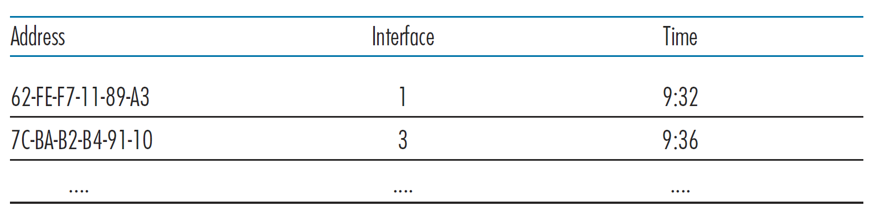
Switch Table
The switch table contains entries for some, but not necessarily all, of the hosts and routers on a LAN.
An entry in the switch table contains
(1) a MAC address,
(2) the switch interface that leads toward that MAC address, and
(3) the time at which the entry was placed in the table.

Slide 32
Self-Learning (I)
A switch has the wonderful property (particularly for the already-overworked network administrator) that its table is built automatically, dynamically, and autonomously— without any intervention from a network administrator or from a configuration protocol.
In other words, switches are self-learning.
This capability is accomplished as follows:

Slide 33
Self-Learning (II)
The switch table is initially empty.
For each incoming frame received on an interface, the switch stores in its table (1) the MAC address in the frame’s source address field, (2) the interface from which the frame arrived, and (3) the current time. In this manner, the switch records in its table the LAN segment on which the sender resides. If every host in the LAN eventually sends a frame, then every host will eventually get recorded in the table.
The switch deletes an address in the table if no frames are received with that address as the source address after some period of time (the aging time). In this manner, if a PC is replaced by another PC (with a different adapter), the MAC address of the original PC will eventually be purged from the switch table.

Slide 34
Switch-Based Ethernet LAN
In a switch-based Ethernet LAN there are no collisions and, therefore, there is no need for a MAC protocol.

Slide 35
Virtual Local Area Networks
A switch that supports VLANs allows multiple virtual local area networks to be defined over a single physical local area network infrastructure.
Hosts within a VLAN communicate with each other as if they (and no other hosts) were connected to the switch.
In a port-based VLAN, the switch’s ports (interfaces) are divided into groups by the network manager.
Each group constitutes a VLAN, with the ports in each VLAN forming a broadcast domain (i.e., broadcast traffic from one port can only reach other ports in the group).

Slide 36
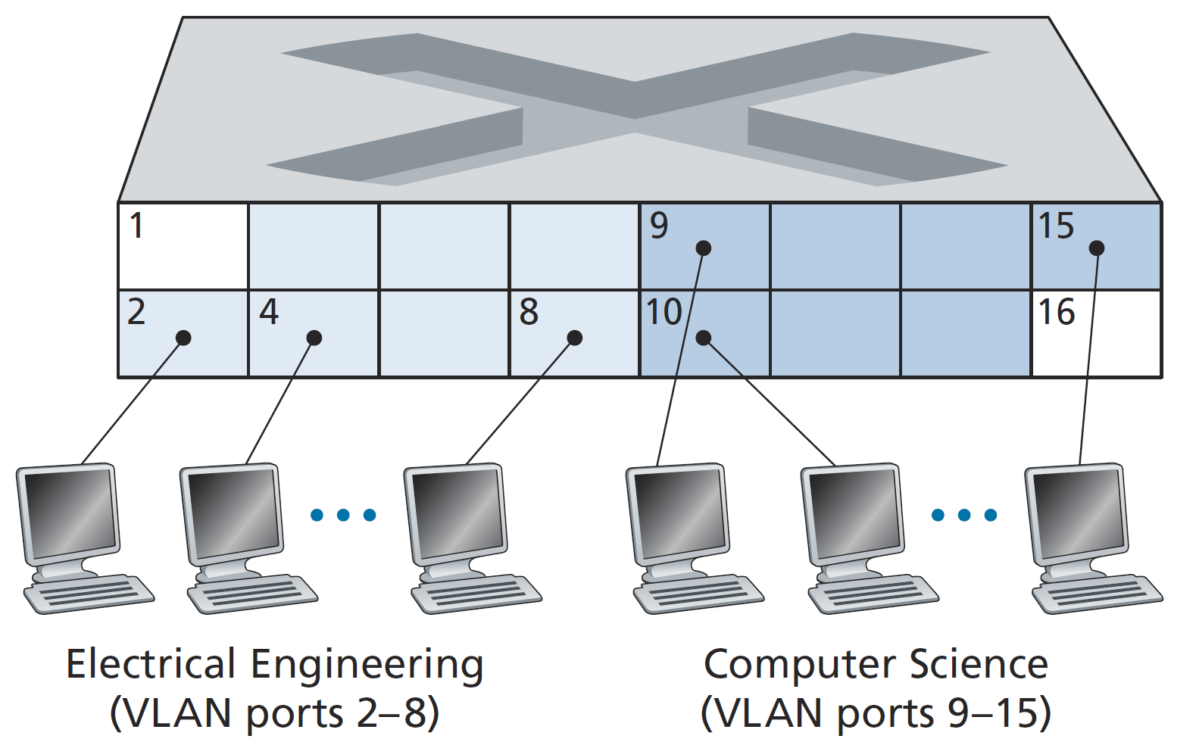
A Single Switch with Two Configured VLANs
Ports 2 to 8 belong to the EE VLAN, while ports 9 to 15 belong to the CS VLAN (ports 1 and 16 are unassigned).

Slide 37
VLANs and Routers
How can traffic from the EE Department be sent to the CS Department?
One way to handle this would be to connect a VLAN switch port (e.g., port 1) to an external router and configure that port to belong both the EE and CS VLANs.
In this case, even though the EE and CS departments share the same physical switch, the logical configuration would look as if the EE and CS departments had separate switches connected via a router.

Slide 38
VLAN Trunking
A more scalable approach to interconnecting VLAN switches is known as VLAN trunking.
In the VLAN trunking approach, a special port on each switch (port 16 on the left switch and port 1 on the right switch) is configured as a trunk port to interconnect the two VLAN switches.
The trunk port belongs to all VLANs, and frames sent to any VLAN are forwarded over the trunk link to the other switch.

Slide 39
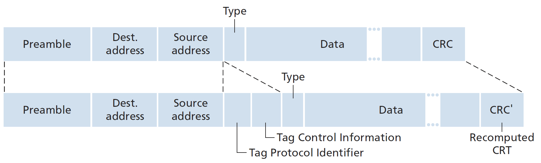
VLAN Tags
How does a switch know that a frame arriving on a trunk port belongs to a particular VLAN?
The IEEE has defined an extended Ethernet frame format, 802.1Q, for frames crossing a VLAN trunk.
The VLAN tag is added into a frame by the switch at the sending side of a VLAN trunk, parsed, and removed by the switch at the receiving side of the trunk.

Slide 40
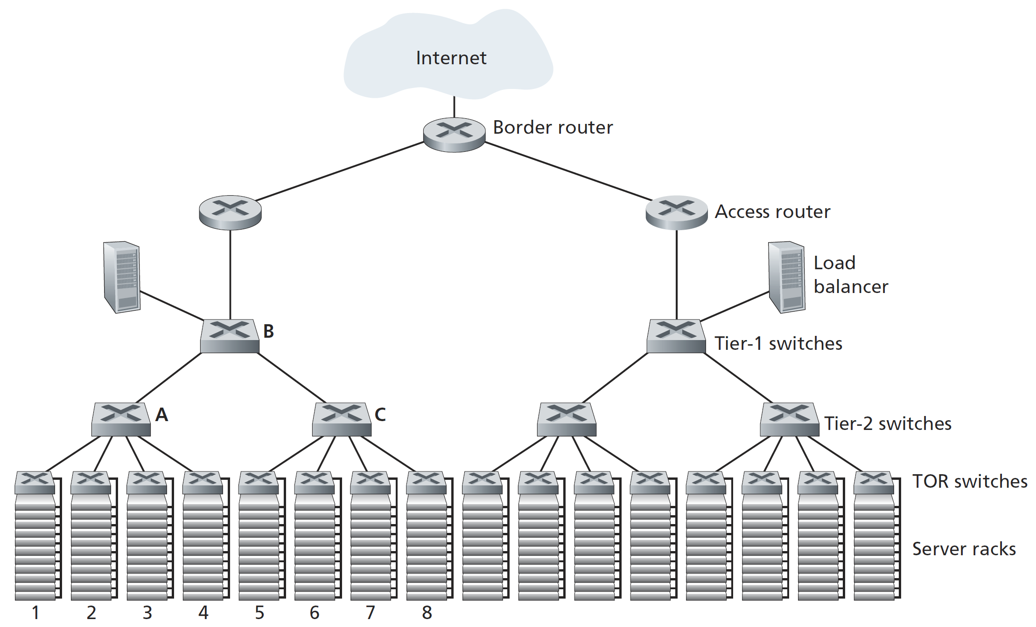
Data Centers

Slide 41
Data Center Networks
Data centers are not only connected to the Internet, but also internally include complex computer networks, called data center networks, which interconnect their internal hosts.
The hosts in data centers, called blades and resembling pizza boxes, are generally commodity hosts that include CPU, memory, and disk storage.
The hosts are stacked in racks, with each rack typically having 20 to 40 blades.

Slide 42
TOR Switches
At the top of each rack, there is a switch, aptly named the Top of Rack (TOR) switch, that interconnects the hosts in the rack with each other and with other switches in the data center.
Specifically, each host in the rack has a network interface that connects to its TOR switch, and each TOR switch has additional ports that can be connected to other switches.
Each host is also assigned its own data-center internal IP address.

Slide 43
Border Routers
The data center network supports two types of traffic: traffic flowing between external clients and internal hosts and traffic flowing between internal hosts.
To handle flows between external clients and internal hosts, the data center network includes one or more border routers, connecting the data center network to the public Internet.

Slide 44
Load Balancers
The load balancer not only balances the work load across hosts, but also provides a NAT-like function, translating the public external IP address to the internal IP address of the appropriate host, and then translating back for packets traveling in the reverse direction back to the clients.
This prevents clients from contacting hosts directly, which has the security benefit of hiding the internal network structure and preventing clients from directly interacting with the hosts.

Slide 45

Thank You & See You Again

